Slide 1
$.Mobile for the Enterprise ($)
Employees get mobile –
business gets mobile.

Slide 2
Why?
Enough coding for the day
Professional developers build enterprise solutions
Mobile is not emerging, it`s already overwhelming
Let’s see why & how you could make it with jQuery mobile

Slide 3

No code?!?

Slide 4

About Me
var speaker = {
name: Adriyan_Vladimirov
tech_interests: [ .NET, mobile, HTML5 ]
role: .NET Practice Manager
// generated_bugs: 463
}

Slide 5
Agenda
Enterprise
Mobility types & categories
Trends
Technical and Business Challenges
Framework
Design & Performance Guidelines
Customizations and Extensibility
Showcase

Slide 6
Enterprise
Type – organization centric
Interconnected
Integrated
Solutions
Data entry -> Processing / QA / Auditing -> Reporting / BI
BPM / BI / CMS / CRM / ERP
Mobile penetration
Mainframe -> Client/Server -> Internet -> Mobile Computing

Slide 7
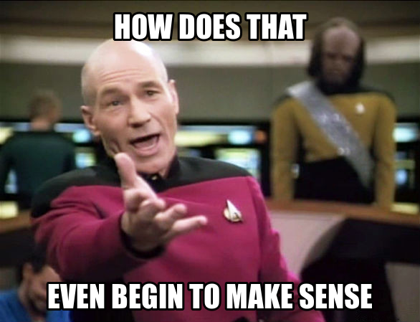
Enterprise?

Slide 8
Mobility approach types
Mobile connectivity
Email, calendar, communicators, news
Mobile productivity
Tools, utilities, data exchange
Field force automation
Dedicated on-site apps, offline sync
Desktop replacement
Re-designed mobile thin clients, intranet

Slide 9
Mobile app categories
People productivity
Travel / Time / Workflow / Leave requests / Collaboration / Employee contacts
Process
LOB – Sales / HR / Field Service & Industry
Analytics
Dashboard & Reporting
Consumer
Payment / Banking / Marketing

Slide 10
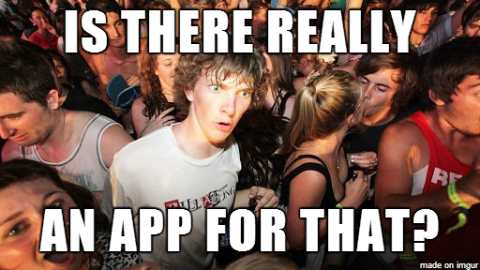
Not enough space

Slide 11
Trends
Hardware advancement
Mobile devices shipments surpassing desktop pc
Tablets replace laptops
Dynamic market share
Lifestyle blends with work style
Consumer computing is mobile
Employees, customers and partners are mobile
BYOD -> CYOD
Mobile Device and Application Management

Slide 12
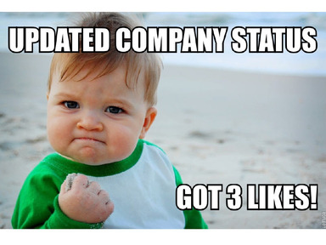
Social benefits…

Slide 13
Trends
Corporate adoption
Mobile enterprise strategy – streamline operations, enhance productivity, reduce costs, keep business competitive
Mobilizing business processes and analytics
Google – mail, maps, drive, hangout, docs, sheets, slides
Microsoft – Xamarin partnership, mobile SharePoint
SAP – leading MADP solution (Gartner 2013)

Slide 14
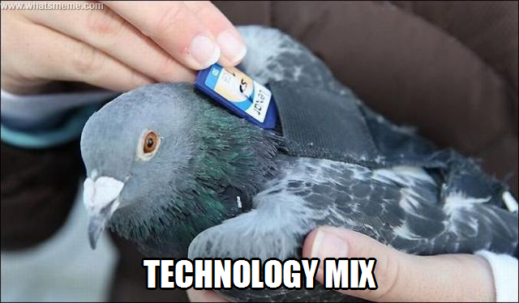
Disaster Recovery Plan

Slide 15
Trends
Technology advancement
Native platforms
HTML5 adoption
Mobile web
Sencha Touch - mobile web Facebook
Kendo UI - hybrid vs. native survey

Slide 16

Charts anyone?

Slide 17
Challenges
Scalability
Back-end integration
Security
Network trust – Intranet / VPN / Public
Performance
Real time notifications
Client caching - storage / offline mode
Distribution channels

Slide 18
Challenges
Data scope
Huge data entry
Variety of data input types
Multiple optional content and edge cases
Dynamic content
Client-side complex processing

Slide 19

Every time I have to register

Slide 20
Challenges
User experience
Responsive UI
Finger-friendly touch interface
App resources
Quality Assurance
Testing on actual devices
Specific device issues & limitations – native or browser

Slide 21
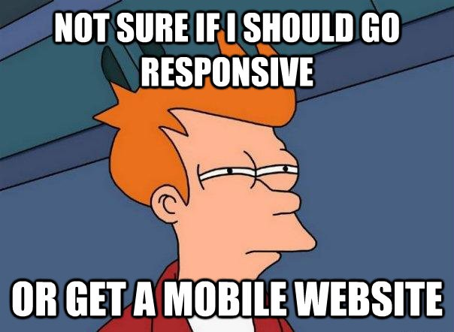
The CTO dilemma

Slide 22
Framework Selection
Native vs. Hybrid vs. Mobile web
Business needs, app requirements, developer skills, timeline
Free vs. Paid
Sencha Touch / KendoUI mobile / MobiScroll Toolkit
Commercial products are already a generation ahead
Performance – scrolling / layouting
HTML5 features & better memory management
Toolbox richness & build-in customization
Integration & Support

Slide 23
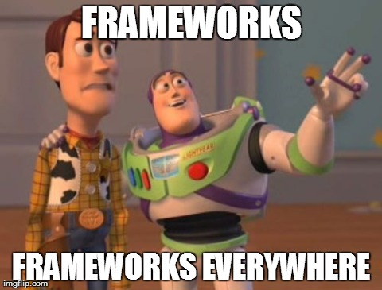
Mobile Frameworks Comparison Chart

Slide 24

Framework – jQuery Mobile
Reliability
Roadmap – current ver. 1.4 RC1
Demos & API
Documentation / Books
Community
Free and extensible

Slide 25
Framework – jQuery Mobile
Features
Layout & theming engine – progressive enhancement / fixed elements
Unobtrusive declaration
Touch friendly UI & touch support
Ajaxified navigation – faster subsequent page load / pre-fetching
Custom build – performance gain
Wide browser coverage

Slide 26
Design Guidelines
Do not port desktop to mobile
Focus on true mobile and field needs
Do rapid prototyping
Speed-up feedback
Mockups from BA & Solutions design
Use device capabilities
GPS
Camera / local files
Vibration*

Slide 27
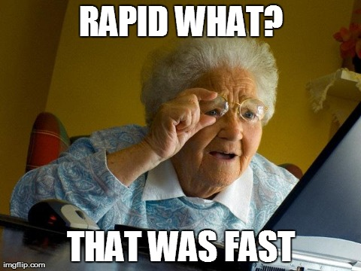
Quick.. and paid

Slide 28
Design Guidelines
Broader device support
Device bugs and limitations
Progressive enhancement
Client-side DOM adoption
CSS media queries
Browser Feature detection
modernizr – custom build!

Slide 29
Design Guidelines
Data organization
Use only necessary sub-set and organize effectively
Make smart decision on organization vs. navigation
Minimize user input
Cache settings & enable offline mode
Pre-fill – default values and common selections
Acquire context – geo location, timing, etc.
Validate before submitting

Slide 30
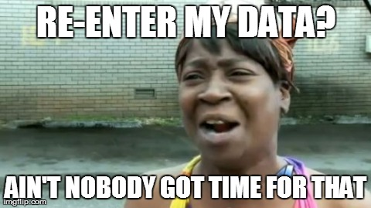
Form validation fail

Slide 31
Performance Guidelines
Applicable improvements
JS & CSS compression & minification
JS AMD / CSS media queries
Evade css transforms & transitions
Evade unnecessary ajax calls
Use native browser control handling – select lists
Performance testing
Yslow.org
Google PageSpeed tools

Slide 32
Customizations & Extensibility
User Interface
Theme roller
Custom sets
Widgets
Based on jQuery UI widget factory
Available 3rd party

Slide 33
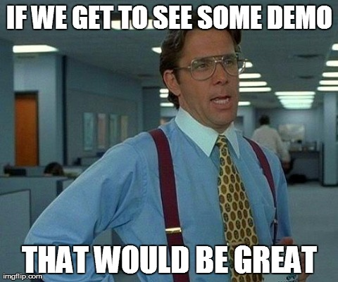
Showcase

Slide 34
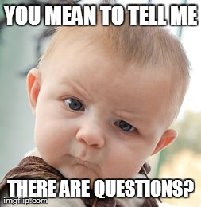

Questions?

Slide 35
















Thanks to our Sponsors:
Diamond Sponsor:
Gold Sponsors:
Silver Sponsors:
Technological Partners:
Bronze Partners:
Swag Sponsors:
Media Partners:

Slide 36
Resources & Links
Technology advancements
http://www.sencha.com/blog/the-making-of-fastbook-an-html5-love-story/ - http://fb.html5isready.com
http://www.kendoui.com/blogs/teamblog/posts/13-10-31/html5-the-platform-of-perception-and-assumptions.aspx - http://cuteness.io
http://www.markus-falk.com/mobile-frameworks-comparison-chart/
Commercial frameworks
http://mobiscroll.com/
http://www.kendoui.com/mobile.aspx
http://www.sencha.com/products/touch/features/
jQuery resources
Prototyping - https://codiqa.com/demo#

